Slide 1


Slide 2


Slide 3


Slide 4


Slide 5
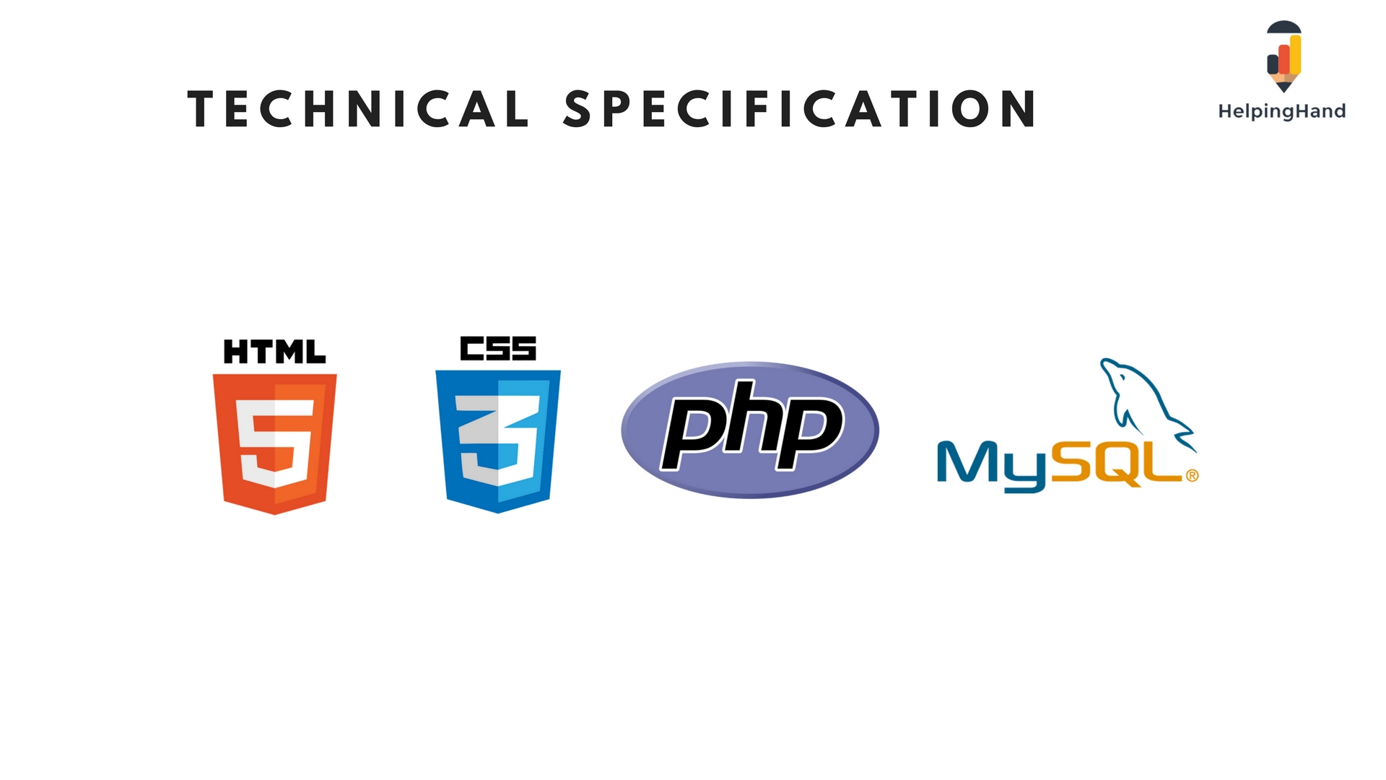

Slide 6


Plan
Project Backlog
Review
Design
New functionality
Sprint Backlog
Sprint
Deploy
Develop
Launch
Test

Slide 7
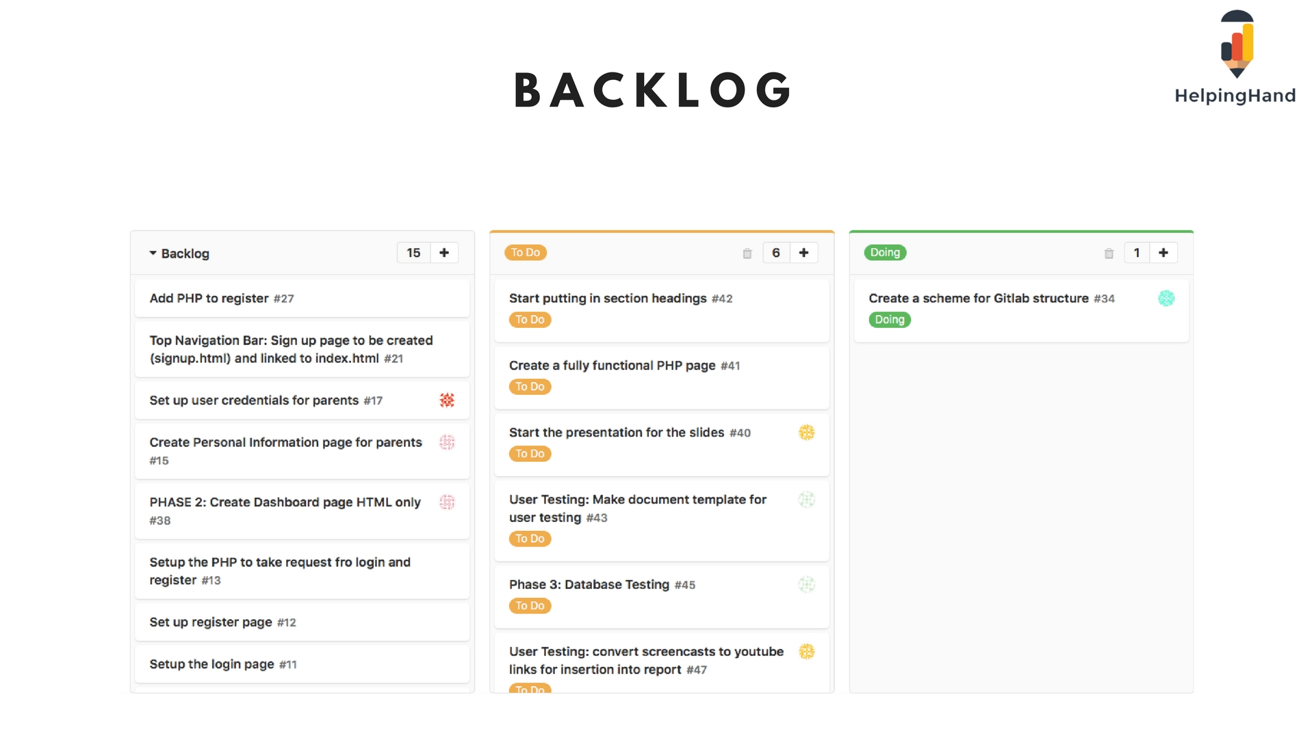

Slide 8


Slide 9
Phase 1
White-box testing
Bugs fixed
Release of MVP
Test of webpages
Test cases set up
Phase 2 of development
Next step: user testing

Slide 10
Phase 2
Release of MVP
User Testing
Controlled assessment
Testing analysis
Video Recording
Screencast
Analysis of user testing
Review feedback and incorporate
Next Step:
Release MVP based on Feedback
More user testing

Slide 11


Slide 12


